Slide 1
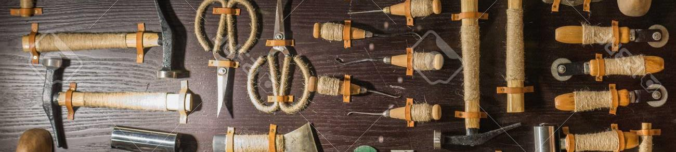
Surviving
It’s (probably) not
as bad as you think
Legacy {code}
SOFTWARE CRAFTSMANSHIP
Desire to be proud of what we do

Slide 2
prelude
What is legacy code?

Slide 3
“Code for an obsolete computer”
Notes:
What Wikipedia claims as the original definition

Slide 4
most current definition
“Code inherited from someone else”
Notes:
Sounds familiar? ….lol this seems to fairly accurate…but it has bust of problems
Lets see
On one occasion I inherited some code that was not legacy code.
On far more occasions, I found myself writing exciting new code legacy that was legacy even before it left my fingures

Slide 5
I inherited some code that was not legacy code
I found myself writing exciting new legacy code that was legacy even before it left my fingers

Slide 6
most visceral definition
“Code I am afraid to modify”
Notes:
This is probably the best definition that describes my state of mind
Because either it’s rigid or it’s fragile, or it’s not redable

Slide 7
more practical definition that points to a solution
“Code without tests”
Michael Feathers
Notes:
The guy who wrote an amazing book I think we all must read

Slide 8
Write some tests
all done, lets go home
If only it were that easy

Slide 9


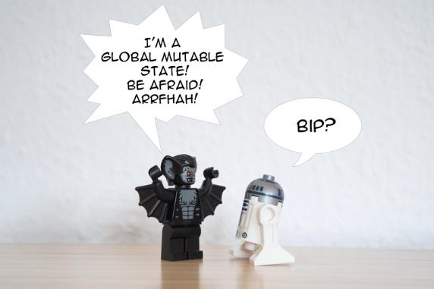
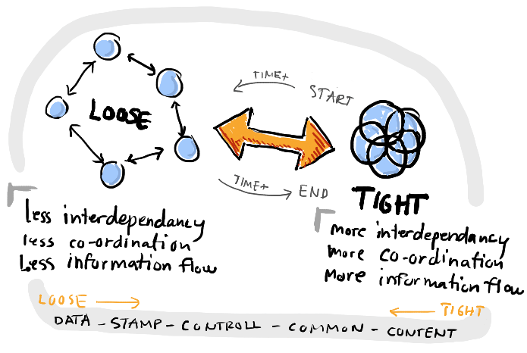
Why it’s not that easy?
Spaghetti
code
Gian
functions
Global mutable
state
Tightly coupled
dependencies
Notes:
https://thevaluable.dev/global-variable-explained/
Example for tight coupling…
Caling a function DB, making an api call log something…etc to test this function I may need two dbs…a third party api

Slide 10
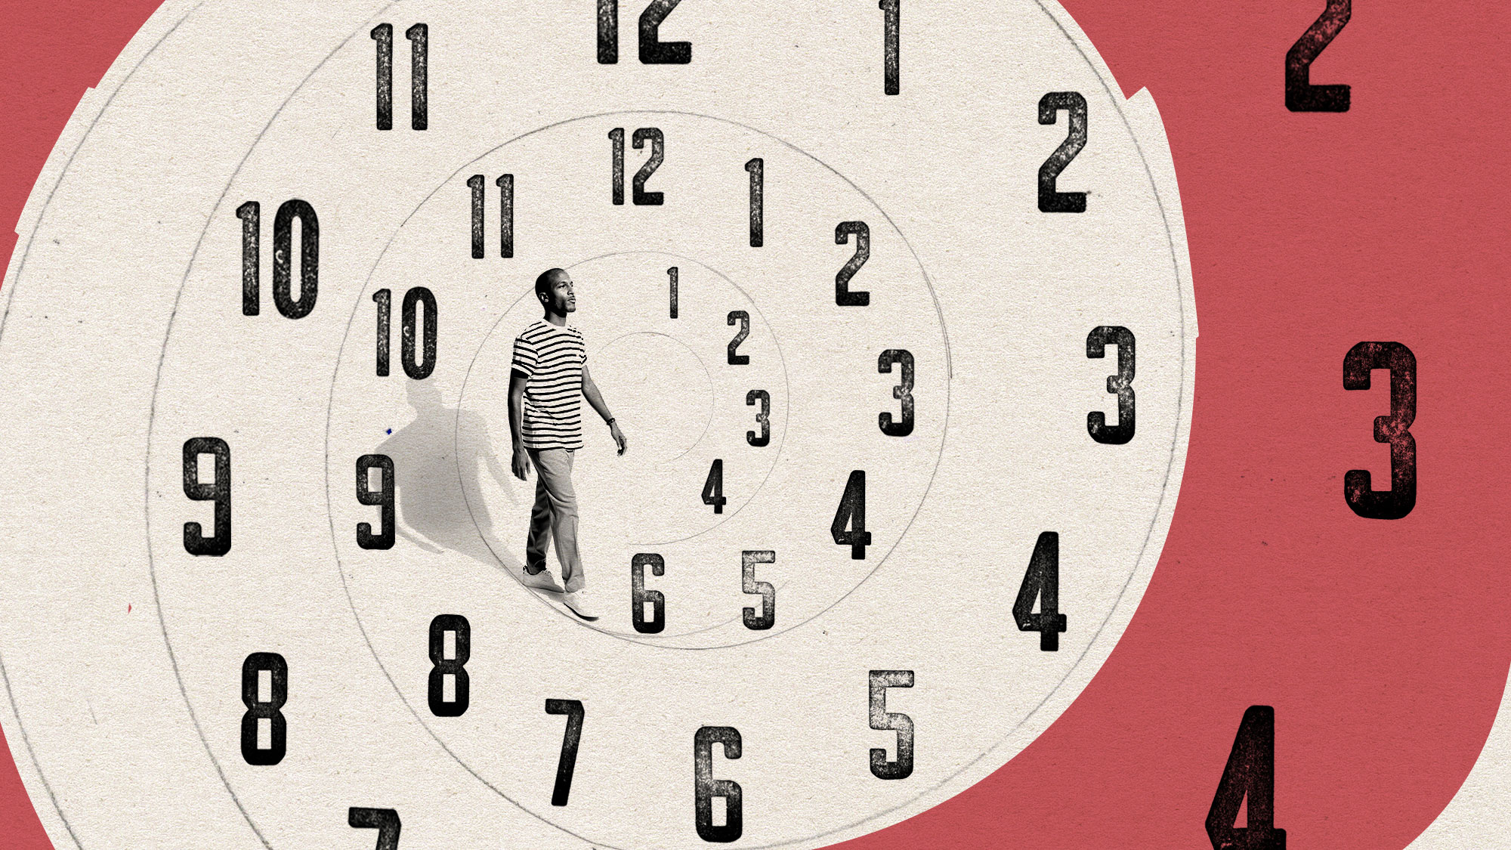
It get’s worse over time
“Hopelessness can be contagious”
Notes:
Changing legacy code is scary
It doesn’t get refactored
We fall for doing hacks

Slide 11
more practical definition that points to a solution
Static analysis tools are your friends
Notes:
The guy who wrote an amazing book I think we all must read

Slide 12
SEAMS
“A seam is a place where you can alter behaviour in your program without editing in that place”
Michael Feathers
Notes:
The guy who wrote an amazing book I think we all must read

Slide 13
more practical definition that points to a solution
Encapsulate the global dependencies
Notes:
The guy who wrote an amazing book I think we all must read

Slide 14
two primary strategies while working with legacy code
Stop making it worse
Notes:
One of the simplest thing that we can do is use the legacy code as an example
A rich library of the examples of the things that we already know we don’t like it.
The things we agree with our team that we don’t like and use it as opportunity to show each other as why something is bad idea to do it that way.
Let’s agree to stop doing that. Let’s agree that even in moments of stress, when we feel deadline pressure and we have an urge to type something that works and forget about it.
We can point back to the code that we don’t like it or the one that annoys us.
We then can say..Hey we did that 120 places, let’s not make it 121

Slide 15
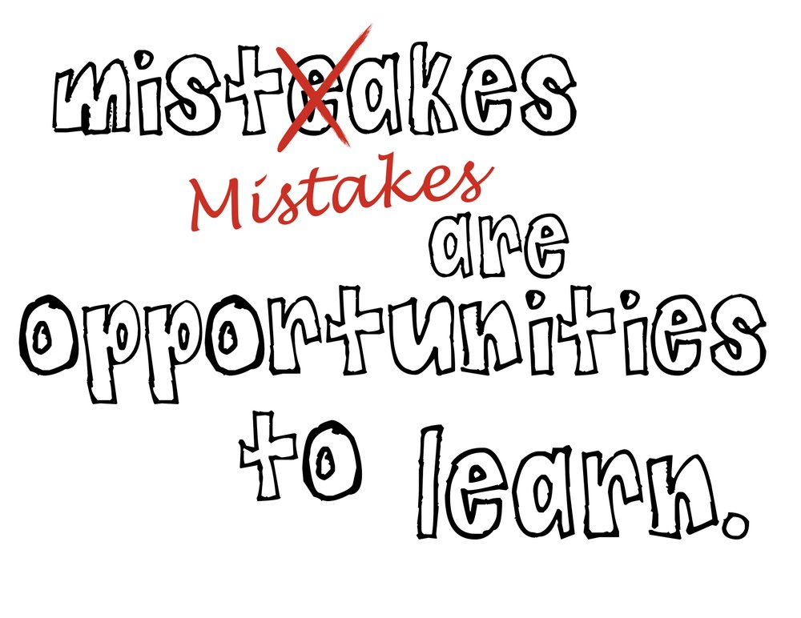
Even if we don’t rescue the legacy code…
…use this as rich examples of what we will not do
Notes:
One of the simplest thing that we can do is use the legacy code as an example
A rich library of the examples of the things that we already know we don’t like it.
The things we agree with our team that we don’t like and use it as opportunity to show each other as why something is bad idea to do it that way.
Let’s agree to stop doing that. Let’s agree that even in moments of stress, when we feel deadline pressure and we have an urge to type something that works and forget about it.
We can point back to the code that we don’t like it or the one that annoys us.
We then can say..Hey we did that 120 places, let’s not make it 121

Slide 16
Anything that annoys in the legacy code becomes the TODO list for new code
Stop making it worse

Slide 17
two primary strategies while working with legacy code
Stop making it worse
Optimize for safety
Notes:
When you are not sure what do? Where to start? With legacy code always pick the safest choice
Typically this is what happens
As you gain experience in general, & as you spend more time with the code, you become more confident to work with
The thigs that
Part of that is to do with building the skill and part of that is becoming familiar with that code

Slide 18


Optimize for safety
Build Skill
Get familiar

Slide 19
Even if we don’t rescue the legacy code, use this as rich examples of what we will not do

Slide 21
Story to drop the hook for “why”
Show an example of neglection of lake near my house
Stress the concept with broken window
Switch to coding to see if it really rots?
Introduce the two main reasons of ROT “FEAR” & “LACK OF CARE”
Show an example of my work and how fear did not let me do the right thing
Time to change?
How “FEAR” was conquered using test automation
Introduce Fragility, Rigidity, Immobility, Non-Readability
Start with “CARE” now
Quickly introduce the definitions of clean code
“Coding is way of Communication”, do it well

Slide 22
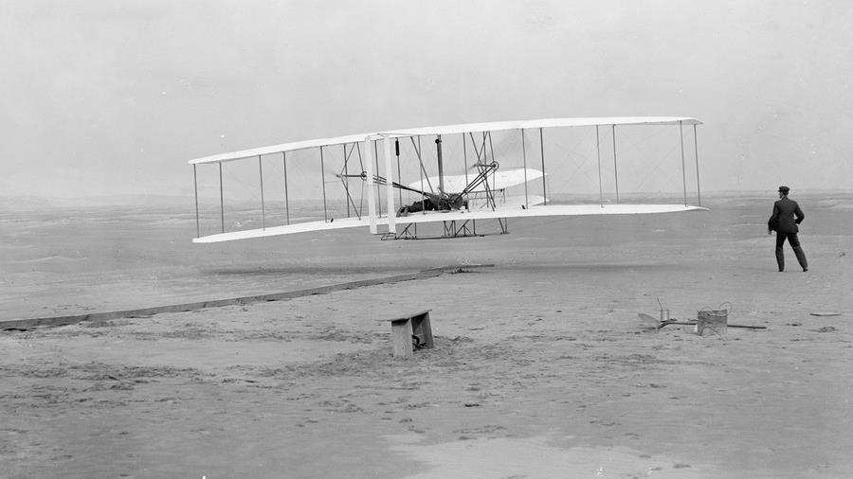
Notes:
The goal was ambitious, Public interest was high. Experts were eager to contribute. Money was readily available.
Armed with every ingredient for success, Samuel Langley set out in the early 1900s to be the first man to pilot an airplane.
Highly regarded, a mathematics professor who had also worked at Harvard. His friends included some of the most powerful men in government and business. Langley was given a $50,000 grant from the war fund, a tremendous amount of money for that time.
Langley and team used the finest materials. With the team he had gathered and ample resources, his success was guaranteed.
Or was it?
A few hundred miles away, Wilbur and Orville Wright were working on their own flying machine. Their passion to flay was so intense that it inspired the enthusiasm and commitment of a dedicated group in their hometown of Dayton, Ohio. There was no funding for their venture. No government grants. No high-level connections. Not a single person on the team had an advanced degree or even a collage education, not even Wilbur or Orville. But the team banded together in a humble bicycle shop and made their vision real. On December 17, 1903, a small group witnessed a man take flight for the first time in history.
How did the Wright brothers succeed where the better-equipped, better-funded and better-educated team could not?
They were pursuing exactly the same goal, but only the Write brothers were able to inspire those around them and truly lead their team to develop a technology that would change the world. Only the Write brothers started with why

Slide 23
Langley and team’s mindset
Write brothers mindset
have to do it
want to do it

Slide 24
In 1982, a theory was introduced by
social scientists
James Q. Wilson
Notes:
With that thought in mind let’s start. 1982 article by social scientists James Q. Wilson

Slide 25
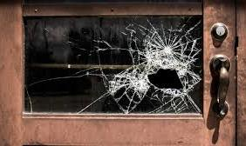
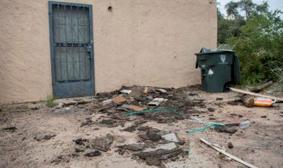
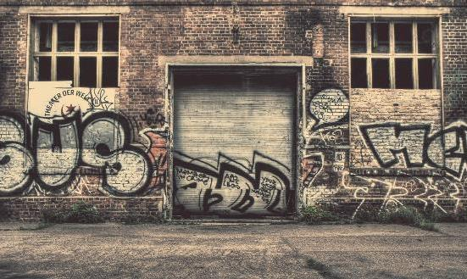
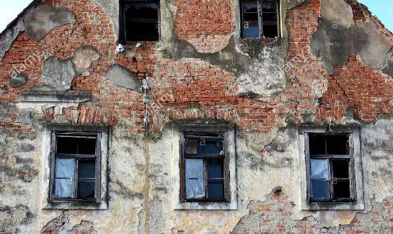
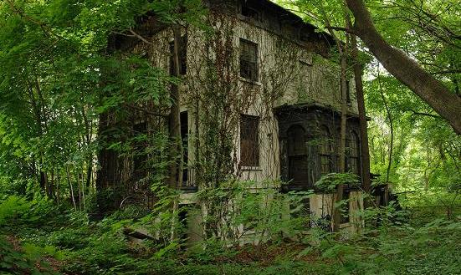
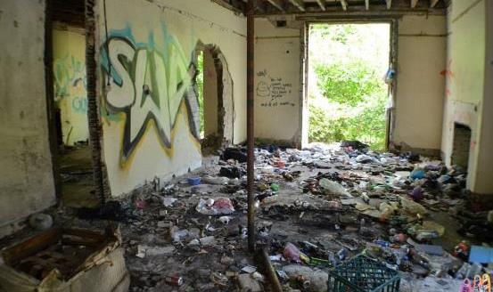
Window
Litter
graffiti
sense of abandonment
becomes reality
Structure
Neglection accelerates the rot faster than any other factor.
Notes:
One broken window, left unrepaired for any substantial length of time, instills in the inhabitants of the building a sense of abandonment—a sense that the powers that be don't care about the building. So another window gets broken. People start littering. Graffiti appears. Serious structural damage begins. In a relatively short space of time, the building becomes damaged beyond the owner's desire to fix it, and the sense of abandonment becomes reality.
How is this related with software

Slide 26
How is this related with the software?
Are the next few questions
sounds familiar?

Slide 27
Changes are hard to do?

Slide 28
Simple Change impacts numerous modules?

Slide 29
Implementing simple change takes forever?

Slide 30
Change in one place harms somewhere completely unexpected area?

Slide 31
Fixing a bug causes <n> more?

Slide 32
Modules are
not reusable
because of their dependencies?

Slide 33
It’s Easier
to do hacks
than by the book?

Slide 34
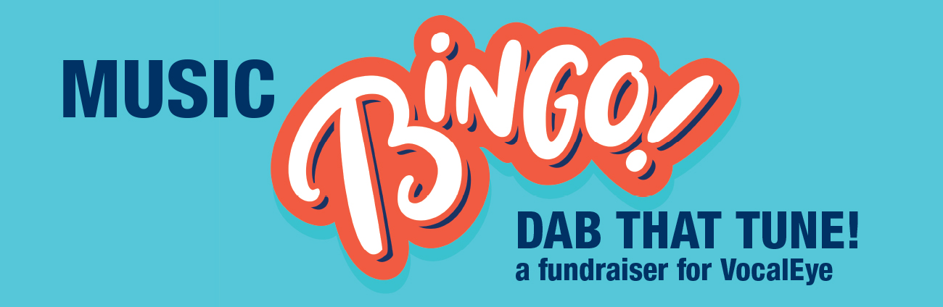

Slide 35
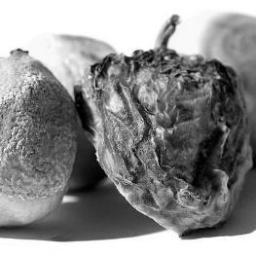
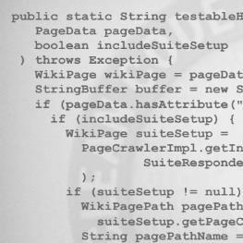
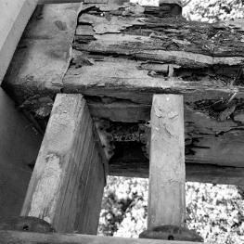
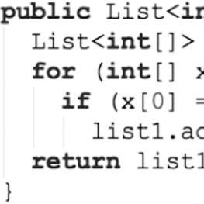
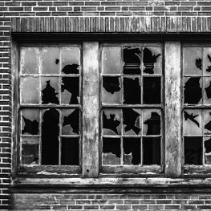
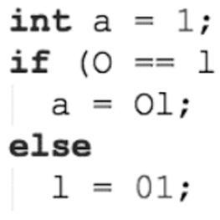
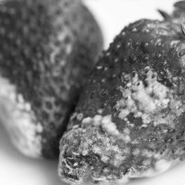
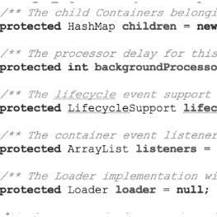
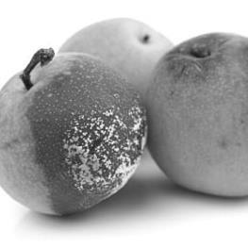
CODE ROT
Has begun?
Bharat
MANE
Notes:
Software rot, also known as bit rot, code rot, software erosion, software decay, or software entropy

Slide 36

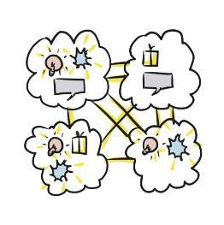
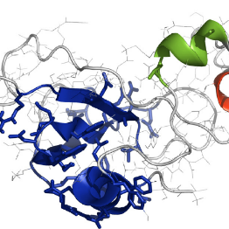
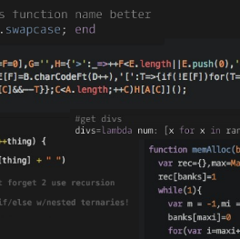
software
erosion
software
decay
We know
it by many names
Software
entropy
Software
rot
Technical
debt
Bharat
MANE
Notes:
Software rot, also known as bit rot, code rot, software erosion, software decay, or software entropy
A measure of this disorder is entropy.

Slide 37
How can we stop it?

Slide 38

Keep the
code clean
At All times

Slide 39
What’s the clean code?

Slide 40
...Does one thing well
-- Bjarne Stroustrup
Inventor of C++

Slide 41
...reads like well-written prose
-- Grady Booch
Inventor of UML

Slide 42
...it was written by someone
who cared
-- Michael Feathers
Author of Working effectively with Legacy Code

Slide 43
...few programmers know
how to write code that
human understand
-- Martin Fowler
Author of Refactoring

Slide 44
...is when each method you read turns out to be pretty much what you expected
-- Ward Cunningham
Inventor of Wiki
Coinventor of Extreme Programming

Slide 45
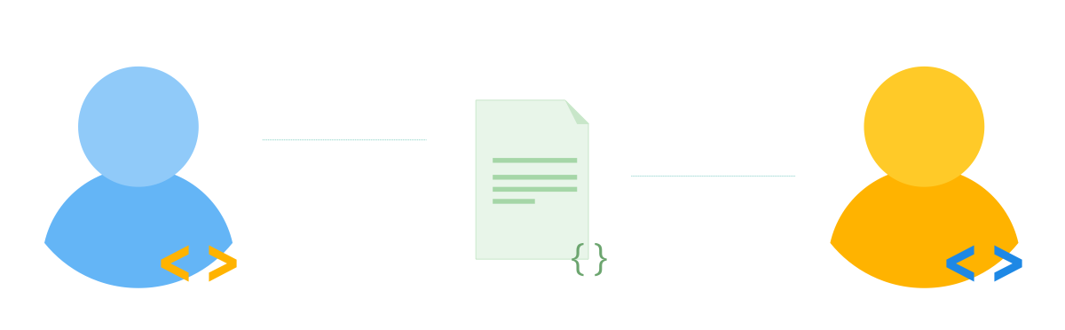
Our goal is
not to code
but to
communicate
Notes:
https://medium.com/the-mighty-programmer/code-communication-ac4a8a4a4f9a

Slide 46
1
2
While making changes
To Existing code
While adding new code

Slide 47
1
2
While making changes
To Existing code
While adding new code

Slide 48
Any idea When
existing Code
becomes legacy?
the moment we stop refactoring
Or Stop caring

Slide 49
Maintenance start the moment we write the code

Slide 50
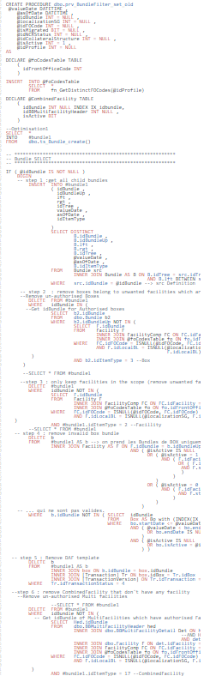
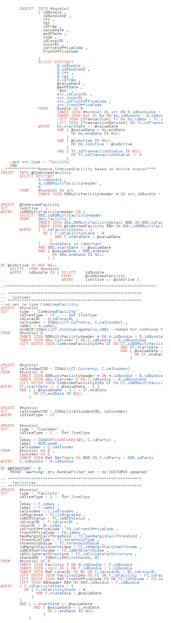
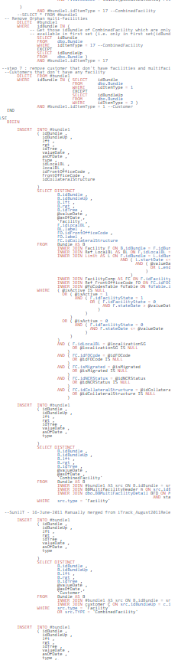
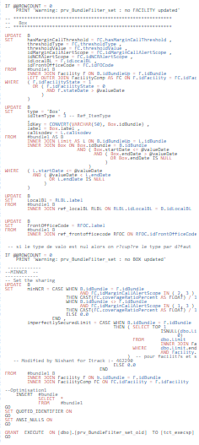
What happens when not cared

Slide 51
“Don’t panic
I know little refactoring
Let’s do it!!”

Slide 52
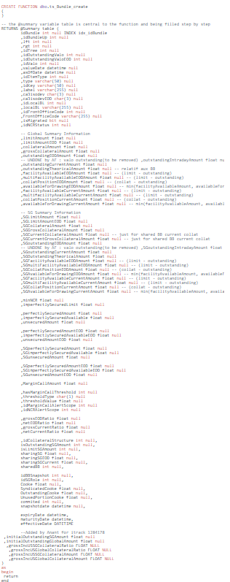
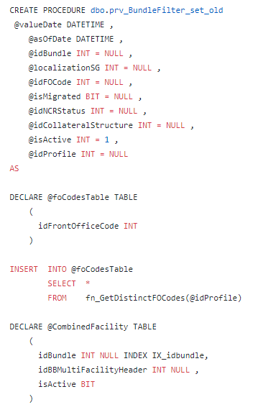
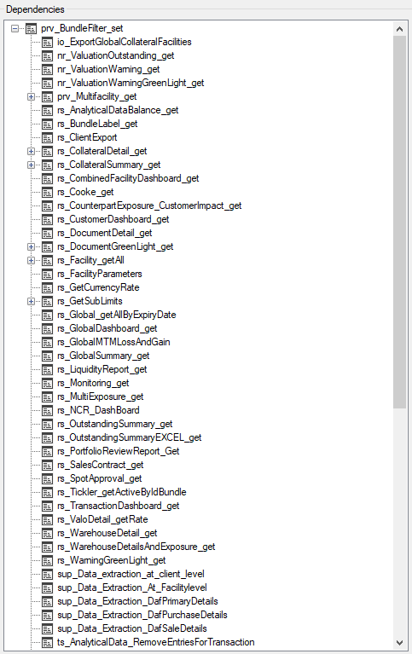
102
columns
100+
Dependencies
I was still scratching the surface

Slide 53


Slide 54
Following
the existing
pattern
Unfamiliar
code
Inexperienced
developers
Why
This Stored
procedure
became like this?
Time
pressure
New to
team
Making
smallest
possible change
Lack of
regulations
Don’t know
When it
happened
hard
To
understand
Bharat
MANE
Notes:
Software rot, also known as bit rot, code rot, software erosion, software decay, or software entropy

Slide 55
Attempt 1
Small change & It failed
Code is Rigid

Slide 56
Attempt 20+
Made changes, it worked!!!
Checked in.
We released ☺

Slide 57
After 2 Days in production
It broke the reports
from completely different part of application
Code is fragile

Slide 58
100+
Dependencies
When looked deeper into the code, dependencies have grown because this module
couldn’t be reused partly

Slide 59
Code is Immobile

Slide 60
Module was full of technical names than business/domain names
Code is Not readable

Slide 61

NON readability
Perfect ingredients for?
IMMOBILIY
fragility
rigidity

Slide 62

FEAR

Slide 63


Slide 64
Test automation
Unit
testing
Functional
testing
zjsonpatch
diffy
Database
NONREG PACK
Finds potential bugs in your system
comparing the output of
new code and your old code.
Notes:
https://diffy.website/
https://github.com/flipkart-incubator/zjsonpatch
https://github.com/twitter-archive/diffy

Slide 65
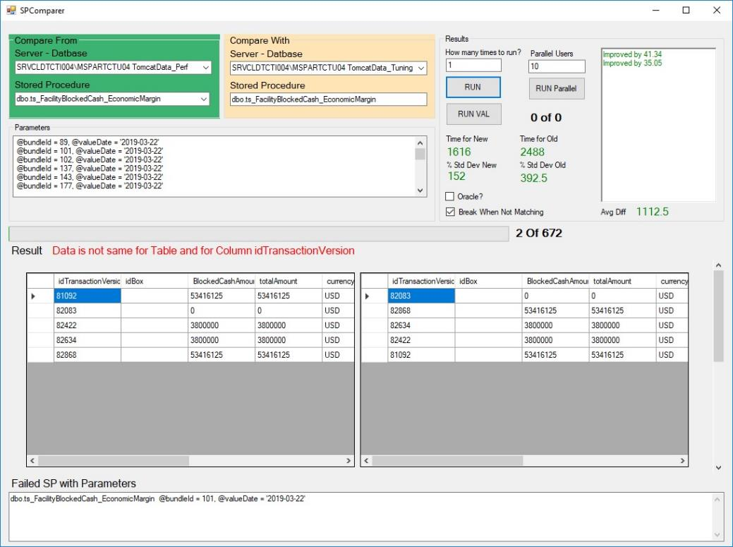
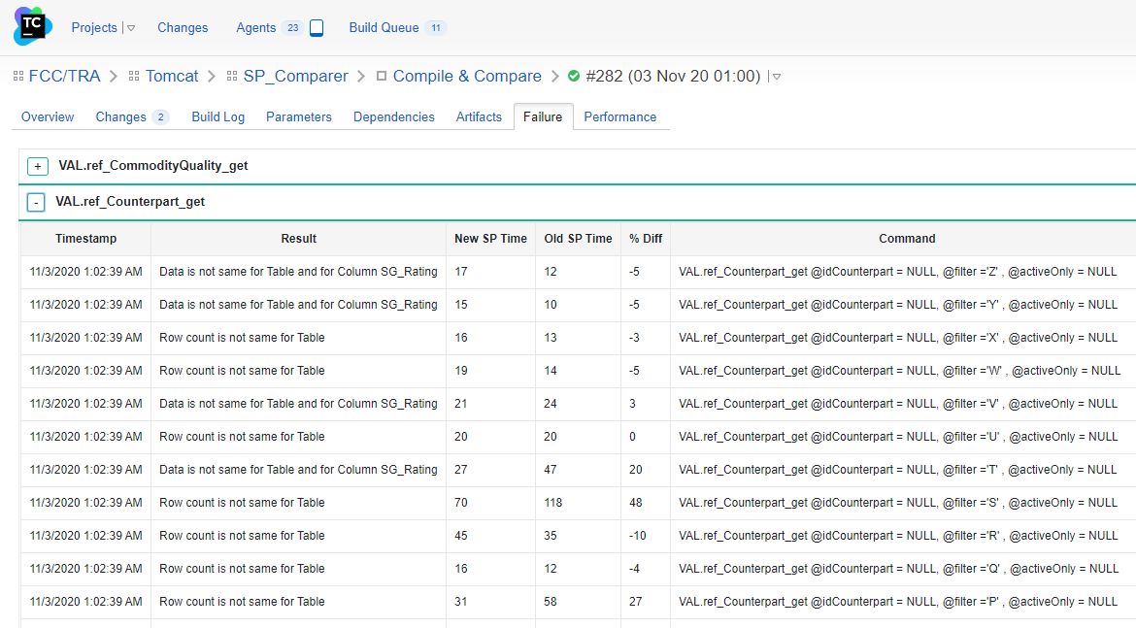
Stored procedure Output Comparer
Stand Alone
Integrated with CI/CD

Slide 66
red
refactor
Fearlessly
refactor
green

Slide 67
1
2
While making changes
To Existing code
While adding new code

Slide 68
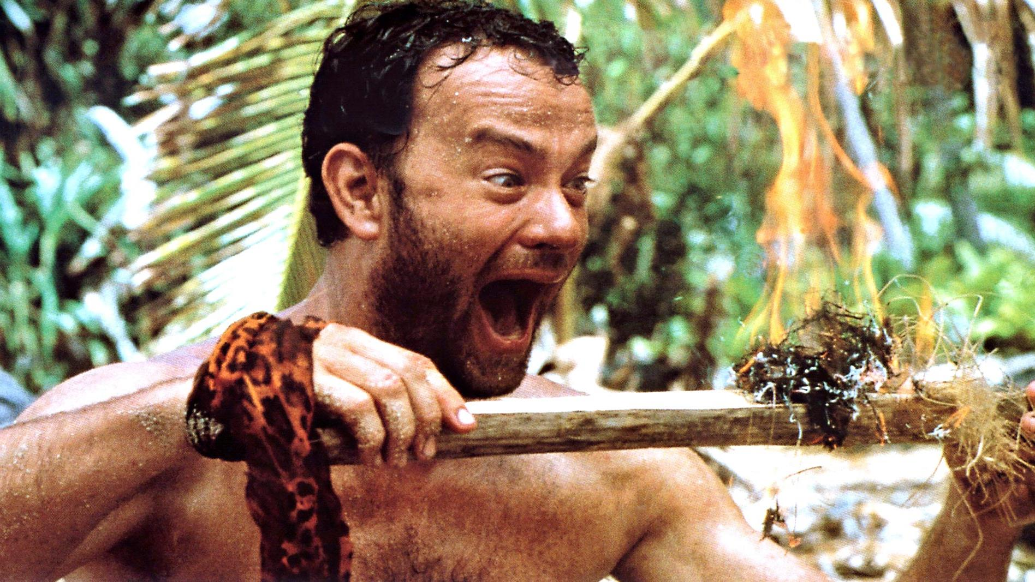
When your code works the first time

Slide 70
It’s just half the job done

Slide 71
The time that the code first works…
…it's the moment in which you start building your career

Slide 72
…It’s the moment in which you start building your design skills

Slide 73



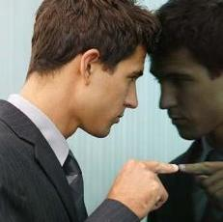
Micro decisions
Self
review
Doubts
remorse
It’s perfect moment to
clean the code

Slide 74
names
functions
comments
Objects
&
Data
Structures
Clean code
topics
formatting
Error
Handling
continuous
Refactoring
Pair
programming
monitoring
Bharat
MANE

Slide 75
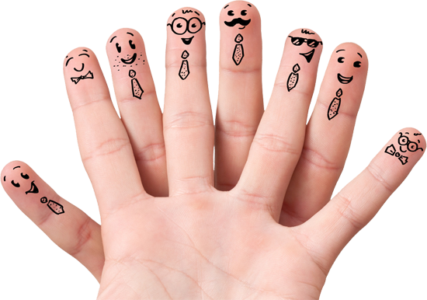
names
The power invested in our fingertips
Notes:
Kevlin Henney tells a story of naming his sons.
He googled the name combination of full name just to ensure that it doesn’t exist
And 13 years later his elder son said what kind name he should give for his twitter handle
Because his friends have some stupid names such as _something or something70 etc.
Kevlin said just try your full name and he said yes it’s available….
Kevlin had said “Yes, 13 years in making”

Slide 76
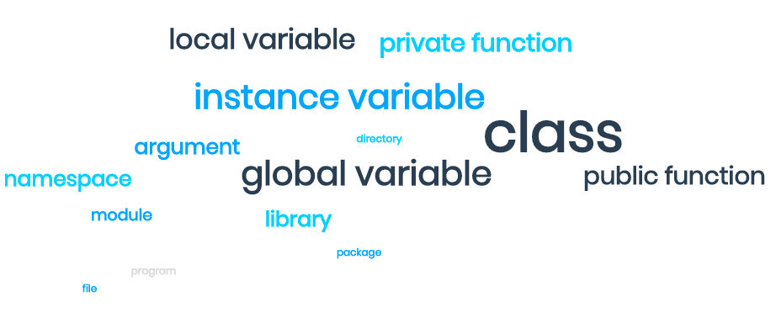

Slide 77
…Because we name so much
…We must use this
power wisely
We must do it well

Slide 78
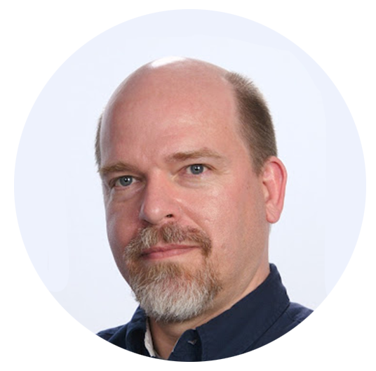
coined the phrase, “implicity of a code”
tim Ottinger
Notes:
https://medium.com/tech-and-the-city/the-naming-checklist-48dfd56be25f

Slide 79
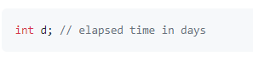
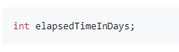
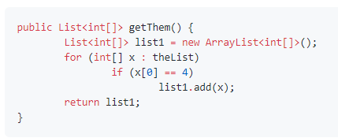
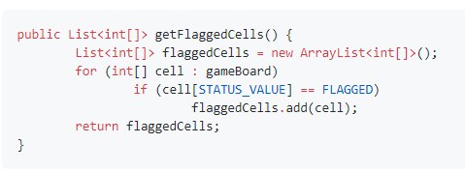
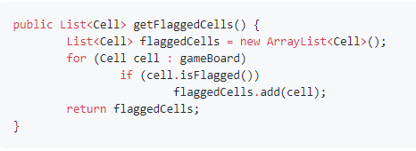
Use Intention-Revealing Names

Slide 80
We communicate

Slide 81
length
Notes:
https://towardsdatascience.com/data-scientists-your-variable-names-are-awful-heres-how-to-fix-them-89053d2855be

Slide 82
Variable name length
it’s scope
Notes:
If the scope is very small, like single line the single letter is ok
Long scope need long names as we have to remember them
Arguments could be single word
Instance variables, their scope is relatively bigger, they could be bigger as well
Global variable’s scope is pretty long so they better be longer as well

Slide 83
function name length
it’s scope
Notes:
It’s exactly the apposite
Bigger the scope smaller the name
More the scope of the function, we are going to call it often
Bigger scope functions needs to have higher abstraction level
As the scope decreases the names length increases
Private faction would have more description names
Private faction called by Private faction will have even longer names
As we are detailing more and more
General rule is, as we go towards the precise functionality or the low level stuff we would have more description name, it’s hard to abstract it.
Such as news titles

Slide 84
Class name length
it’s scope
Notes:
Global classes have one word names
Same is with mostly abstract or base classes
Derived classes have more than a word names
Because they are doing precise things

Slide 85
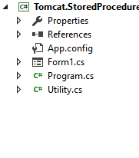
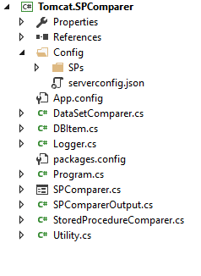
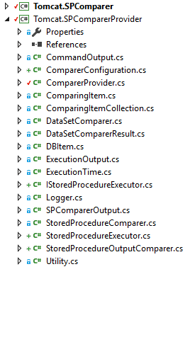
V 1.0
V 2.0
V 3.0
V 4.0
???

Slide 86
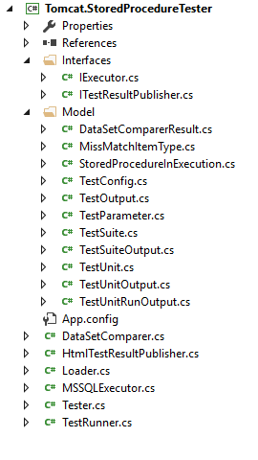
The moment name was given to this class the whole thing became crystal clear
Good names tells the context of entire system

Slide 87
We communicate

Slide 88
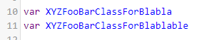

Avoid Disinformation
Using lower case l
(looks like number-1) and uppercase O (looks like number-0) are also unhelpful.
“A software author must avoid leaving false clues which obscure the meaning of code.”
- Ottinger

Slide 89
We communicate

Slide 90



Use Pronounceable Names
currency
“Programming is a social activity” - Bob Martin
Notes:
If you can’t pronounce a variable name it will be very hard to discuss a piece of code.

Slide 91
We communicate

Slide 92




Use Searchable Names
Replace literals with constants

Slide 93
Class Names
A class name should
be a noun,
not a verb.
Avoid words like
Manager, Processor, Data, or Info.
Good names could be:
Tester, TestSuite, TestUnit, HtmlTestResultPublisher.

Slide 94

Method Names
Methods should have verb
Good names could be:
Save(), Run(), Publish(), Valuate(),
Consolidate()
RunNettingValuation(),
GenerateAnalyticalOutstanding()
ConvertQualityUnit()

Slide 95
We communicate

Slide 96
however

Slide 97
THERE ARE NO GOOD NAMES
IT’S CONTINEIOUS PROCESS
EVERY TIME YOU HAVE BETTER UNDERSTANDING OF CODE,
YOU FIND A BETTER NAME

Slide 98

England's Eton College
Notes:
A tourist visiting England's Eton College asked the gardener how he got the lawns so perfect. "That's easy," he replied, "You just brush off the dew every morning, mow them every other day, and roll them once a week." "Is that all?" asked the tourist. "Absolutely," replied the gardener. "Do that for 500 years and you'll have a nice lawn, too."

Slide 99



“That’s easy”
just brush
off the dew
every morning
mow them
every
other day
and roll
them
once a week

Slide 100

Do that for 500 years & you'll have a nice lawn, too
Notes:
Say it with the intent or reword

Slide 101

care

Slide 102
tl;dr

Slide 103
Neglection accelerates rot faster than any other factor

Slide 104
test automation gives you power of
fearless refactoring

Slide 105
Find opportunities of automation in absence of tests for old code

Slide 106
Use the gifted power of naming things wisely

Slide 107
Use Intention-Revealing Names

Slide 108
Avoid Disinformation

Slide 109
Use Pronounceable Names

Slide 110
Use Searchable Names

Slide 111
Class Names must be nouns
Method Names must be verbs

Slide 112
Remember we don’t code,
we communicate

Slide 113
Remember we don’t code,
we communicate

Slide 114
Don’t fear
&
take care

Slide 115
MINDSET
Want to do it

Slide 116

Q&A
Bharat
MANE

Slide 117
ANNEXTURE
Bharat
MANE

Slide 118










Good reads
Bharat
MANE

Slide 119



principles
patterns
practices
heuristics
Grind that knowledge into muscle memory
+
=
knowledge
work
craftsmanship
Notes:
There are two parts to learning craftsmanship: knowledge and work. You must gain the knowledge of principles, patterns, practices, and heuristics that a craftsman knows, and you must also grind that knowledge into your fingers, eyes, and gut by working hard and practicing.

Slide 120
“Honesty in small things is not a small thing.”
-Danish Saw
Notes:
A danish saw (proverb)
Small things matter.
Cleanliness is next to godliness.
He who is faithful in little is faithful in much
A stitch in time saves nine.
A bad penny always shows up.

Slide 121

Notes:
https://medium.com/continuousdelivery/refactoring-workflows-da982d08d2c7

Slide 122

Unit of
Code quality
Notes:
Are we debugging in a panic, poring over code that we thought worked?

Slide 123

When we proclaim the design is done and accept no more changes
When we move the system into maintenance and change the team's process

Slide 124
There are only two hard things in Computer Science:
cache invalidation and naming things

Slide 125


Most of the IDEs gives you very
safe way to rename
variables, classes, functions
Especially private stuff is completely sage
Comprehension refactoring

Slide 126

Manifesto
for Software Craftsmanship
Bharat
MANE

Slide 127

XP has simple rules that are based on 5 values.
Communication
Everyone on a team works jointly at every stage of the project
Simplicity
Developers strive to write simple code bringing more value to a product, as it saves time and efforts.
:
Feedback
Team members deliver software frequently, get feedback about it, and improve a product according to the new requirements.
Respect
Every person assigned to a project contributes to a common goal.
Courage
Programmers objectively evaluate their own results without making excuses and are always ready to respond to changes.
Bharat
MANE

